Slide 1
TOPICS
Dental & Vision Care Options
Short Term Disability
Federal Employee Group Life Insurance (FEGLI)
The Solution to FEGLI – Union Member Life
NEW EMPLOYEE
ORIENTATION

Slide 2
DENTAL & VISION CARE

Slide 3
AFGE Member Dental
▪ Dental Plans as low as $7 bi-weekly
▪ Low Co-pays
▪ $5 office visits
▪ No charge for oral exams, bitewing x-rays or preventative cleanings
▪ No Waiting Periods!
▪ No Annual Maximum
▪ Works with other dental plans or can stand alone
NEW EMPLOYEE
ORIENTATION

Slide 4
AFGE Member Vision
This plan’s options have you covered and make eye care
affordable. You have access to one of the largest vision networks
in the United States, with more than 35,000 participating optometrists, ophthalmologists, and national retail locations, including LensCrafters®, Pearle Vision®, Sears® Optical, Target® Optical, and JCPenney® Optical.
NEW EMPLOYEE
ORIENTATION

Slide 5
SHORT TERM DISABILITY

Slide 6
Short Term Disability
Income Protection
This plan pays up to 60% of your monthly income
It covers accidents immediately!
You choose your waiting period on sickness as well as your benefit period
It pays in addition to sick leave or annual leave
This plan is flexible so it can be individually designed to meet YOUR needs
Covers pregnancy
Covers pre-existing conditions after 1 year
NEW EMPLOYEE
ORIENTATION

Slide 7
FEDERAL EMPLOYEES GROUP LIFE
(FEGLI)
FEGLI Rates not guaranteed and subject to change; Rate Information for the calculations provided by the OPM web site (www.opm.gov). Rates current as of 01/01/2016.

Slide 8
FEGLI Bi-Weekly Cost Analysis
Active at Work
SALARY | Basic | Option A | Option B | Option C
$50,000 | $52,000 | $10,000 | $250,000 | $25,000 $12,500
NEW EMPLOYEE
ORIENTATION

Slide 9
FEGLI Bi-Weekly Cost Analysis
Eleven Different Age Groups
Under 35
35-39
40-44
45-49
50-54
55-59
60-64
65-69*
70-74*
75-79*
80+*
NEW EMPLOYEE
ORIENTATION

Slide 10
FEGLI Bi-Weekly Cost Analysis
Active at Work
Salary $50,000 | Basic $52,000 | Option A $10,000 | Option B $250,000 | Option C $25,000 $12,500 | Bi-Weekly Premium | Total Coverage
Under 35 | 7.80 | 0.20 | 5.00 | 1.11 | $14.11 | $364,000
35-39 | 7.80 | 0.30 | 7.50 | 1.36 | $16.96 | $343,200
40-44 | 7.80 | 0.40 | 10.000 | 2.05 | $23.00 | $317,200
45-49 | 7.80 | 0.70 | 17.50 | 2.95 | $28.96 | $312,000
50-54 | 7.80 | 1.10 | 27.50 | 4.59 | $40.99 | $312,000
55-59 | 7.80 | 2.00 | 50.00 | 7.41 | $67.21 | $312,000
60-64 | 7.80 | 6.00 | 110.00 | 13.50 | $137.30 | $312,000
65-69* | 7.80 | 6.00 | 135.00 | 15.69 | $158.49 | $312,000
70-74* | 7.80 | 6.00 | 240.00 | 19.15 | $266.95 | $312,000
75-79* | 7.80 | 6.00 | 450.00 | 26.31 | $484.11 | $312,000
80+* | 7.80 | 6.00 | 660.00 | 36.00 | $703.80 | $312,000
* This premium is only for active employees working past age 65
NEW EMPLOYEE
ORIENTATION

Slide 11
Total Cost to Stay in
FEGLI to Age 65
AGE | COST TO 65 | AGE | COST TO 65
20 | $46,018.00 | 25 | $44,184.60
30 | $42,350.80 | 35 | $40,517.00
40 | $38,312.00 | 45 | $35,678.80
50 | $31,914.60 | 55 | $26,585.80
60 | $17,849.00
NEW EMPLOYEE
ORIENTATION

Slide 12
Monthly Coverage and Cost Analysis
Retiree – 75% Reduction (No Additional Premiums)
 | Basic $52,000 | Option A $10,000 | Option B $250,000 | Option C $25,000 | TOTAL $312,000
End of Age 65 | $39,520 | $7,600 | $190,000 | $19,000 | $237,120
End of Age 66 | $27,040 | $5,200 | $130,000 | $13,000 | $162,240
End of Age 67 | $14,560 | $2,800 | $70,000 | $7,000 | $87,360
End of Age 68 | $13,000 | $2,500 | $10,000 | $1,000 | $25,500
End of Age 69 | $13,000 | $2,500 | $0 | $0 | $15,500
NEW EMPLOYEE
ORIENTATION

Slide 13
Monthly Coverage and Cost Analysis RETIREE
Cost for No Reduction of Basic, Option B & Option C
Ending Salary $50,000 | Basic $52,000 | Option A $10,000 | Option B $250,000 | Option C $25,000 $12,500 | Monthly Cost | Annual Cost
55-59 | $117.78 | $5.85 | $124.50 | $16.45 | $264.58 | $3,174.96
60-64 | $117.78 | $13.00 | $281.75 | $29.25 | $441.78 | $5,301.36
65-69 | $100.88 | $0.00 | $335.75 | $34.00 | $470.63 | $5,647.56
70-74* | $100.88 | $0.00 | $617.50 | $39.00 | $757.38 | $9,088.56
75-79* | $100.88 | $0.00 | $975.00 | $52.00 | $1,127.88 | $13,534.56
80+* | $100.88 | $0.00 | $1,300.00 | $71.50 | $1,472.38 | $17,668.56
* This premium is only for active employees working past age 65
NEW EMPLOYEE
ORIENTATION

Slide 14
Federal Employees Almanac 2018
Discontinuing FEGLI Coverage
Unless you've assigned it to someone else, you may discontinue
your Basic or Optional insurance coverage at any time by providing
a written waiver of insurance coverage to your employing office
(or to the OPM in the case of a retiree) by filing a Life Insurance
Election form (SF 2817) available from the sources listed in Filing
a FEGLI Claim, above. However, there are situations in which your insurance can be discontinued without your consent.
Separation from service other than for retirement.
After 12 months of non-pay status.
Any other employment change that results in your ceasing to be a FEGLI-eligible employee, such as a move to a position excluded from eligibility.
Termination of your annuity.
At the end of the pay period in which it is determined that your pay, after all other deductions, is insufficient to cover the required withholding for your insurance. However, you may arrange to continue your insurance coverage by making payments directly to your agency or retirement system.
NEW EMPLOYEE
ORIENTATION

Slide 15
THE SOLUTION TO FEGLI
Union Member Life

Slide 16
THE SOLUTION TO FEGLI
Union Member Life
Available for all AFGE Members including those age 50 and older
No increased premium
Coverage to age 100
Individual policy that is portable (if you change jobs it goes with you)
Builds Cash Value
Take it into retirement
Save the equivalent of your annual salary with Union Member Life
NEW EMPLOYEE
ORIENTATION

Slide 17
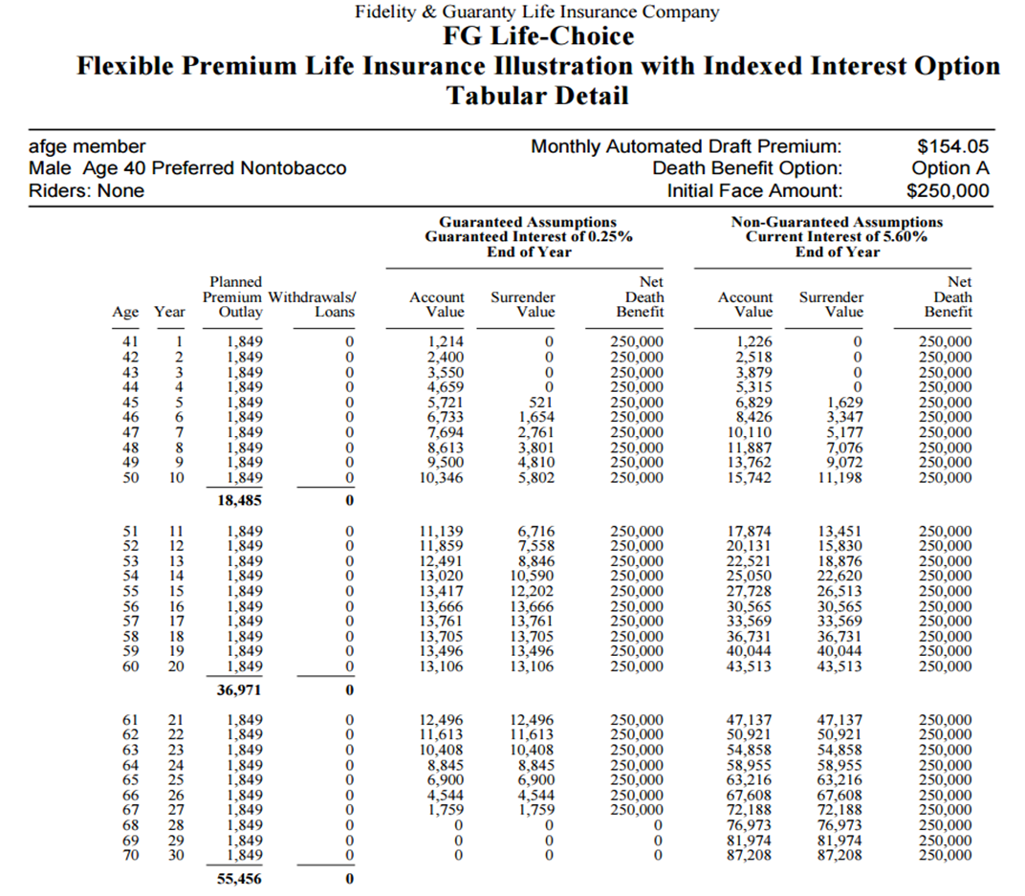
NEW EMPLOYEE
ORIENTATION

Slide 18
Total Career Savings by Age 65
FEGLI (premiums paid in) | $43,439.00
Cash Value | 0.00
Life Insurance | $15,500.00
Union Member Life | $36,801.00
Cash Value | 50,949.00
Life Insurance | 250,000.00
TOTAL SAVINGS
$57,587.00
NEW EMPLOYEE
ORIENTATION

Slide 19
In Closing…
The Union is looking out for you in EVERY aspect of your life.
Make educated decisions when planning for your future.
Use us as an additional resource of information and assistance. Contact me for any questions you may have.
NEW EMPLOYEE
ORIENTATION

Slide 20
Contact Info
Scott Ellenwood
UNION Benefits
Cell (719) 494-7793
Email: Sellenwood@benefitarchitects.com
NEW EMPLOYEE
ORIENTATION

